Slide 1
CONGENITAL SOFT TISSUE DYSPLASIAS IN CHILDREN
Tanh Nguyen Tran Viet, MD
Khai Truong Dinh, MD và Cs
Khoa Ngoại BV Nhi Đồng 2

Slide 2
Introduction
Localized malformations of covering soft tissues in children, presenting as various clinical entities.
The pathological conditions were termed:
  Giant hamartomas, segmentary gigantism,
  Hypertrophic limbs, phacomatosis

Slide 3
Introduction
Syndromes
  Parkes-Weber
  Klippel Trenaunay
  Proteus
  Servelle Martorell
  Mafucci
  Bannayan-Riley-Ruvalcaba

Slide 4
Introduction
These syndromes were regrouped in to the term congenital soft tissue dysplasias (CSTDs)
Histopathological feature: overgrown cells of well-defferentiated tissues

Slide 5
HISTORICAL REVIEW
1958, Chassaignac, 2 cases
“The limbs in the left side are those of a person of normal build; those on the right seem to belong to a giant”
1900, Klippel and Trenauney, syndrome
Capillary lymphaticovenous malformation (CLVM) and associated soft tissue and skeletal overgrowth of the extremity
1907, Parkes-Weber, syndrome
Capillary arteriovenous fistulas (CAVF) and capillary arteriovenous malformations (CAVM) are combined with hypertrophy of the bone and muscle of the affected limb

Slide 6
HISTORICAL REVIEW
1989, Pellerin,
Congenital soft tissue dysplasia: a new malformation entity and concept.
1994, Martelli,
Congenital soft tissue dysplasias: a morphological and biochemical study

Slide 7
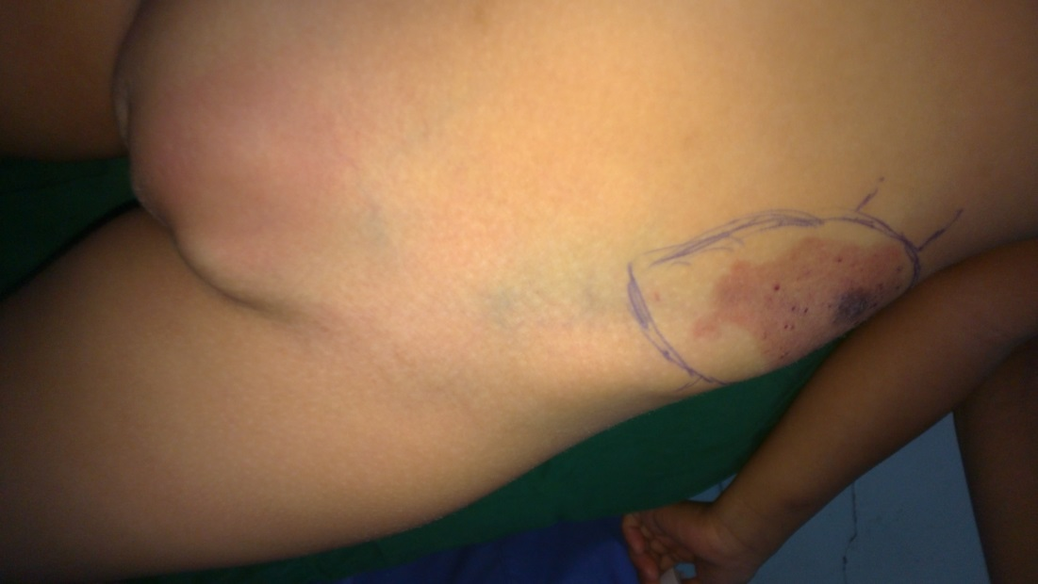
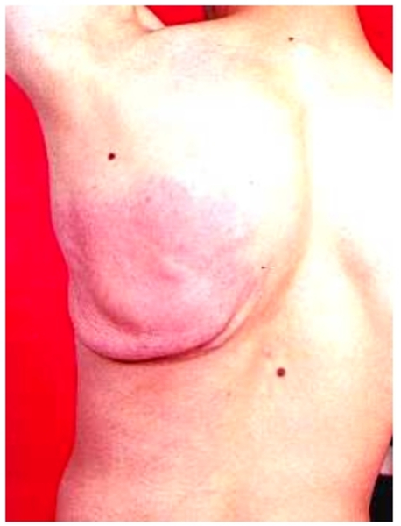
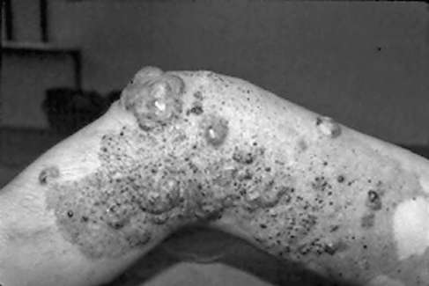
CLASSIFICATION – Pellerin (1989)
1. Localised CTSDs
With or Without angiodysplasia

Slide 8
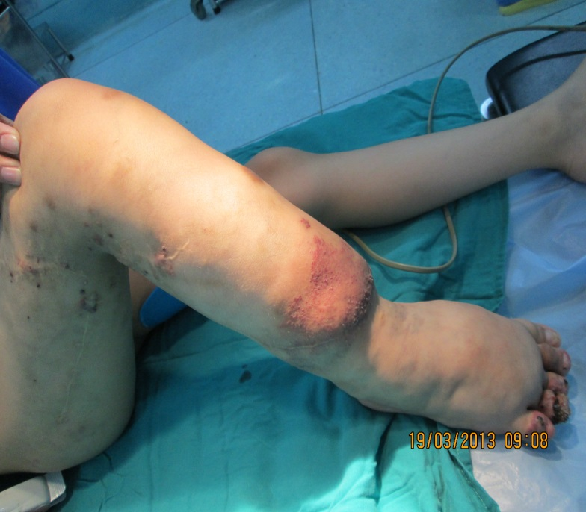
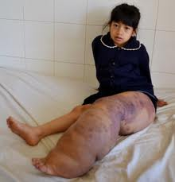
CLASSIFICATION
2. Segmental CSTDs Without Gigatism
With or Without angiodysplasia

Slide 9
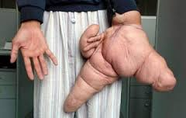
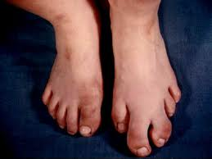
CLASSIFICATION
3. CSTDs with Gigantism
With or without angiodysplasia

Slide 10
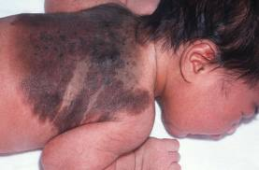
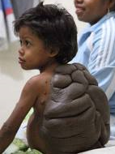
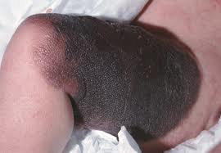
CLASSIFICATION
4. Ectodermal CSTDs
# Giant nevus (pure or associated)

Slide 11
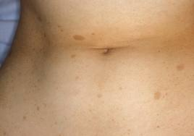
CLASSIFICATION
5. CSTDs in Recklinghausen’s disease
Not neurofibromatosis

Slide 12
CLASSIFICATION – Martelli (1994)
Segmental dysplasia with or without gigantism
Neuroectodermal dysplasia (in von Recklinghausen's disease and nevi)

Slide 13
Comments - similarities
Anomalies remains identical throughout life
Growth of dysplasia remains stable, similar rate with body growth
CSTDs are benign lesions
and do not involve muscle or main deep vessel

Slide 14
Treament
Medical care: symptomatic
  Compression garments
  Pain management
  Antibiotics, corticosteroids
  Anticoagulant therapy
Surgical care: depends of types of dysplasias
  Operation: Dysplasias Resection
  Endovascular intervention: Embolisation
  Sclerotherapy: Alchohol 99.5º, Bleomycin

Slide 15
Surgical care
Operation:
CSTD is a benign malformation
No recurrence
Embolisation: fast-flow vascular malformation
(ateriovenous fistulas)
Sclerotherapy: slow-flow vascular malformation
(venous lakes)

Slide 16
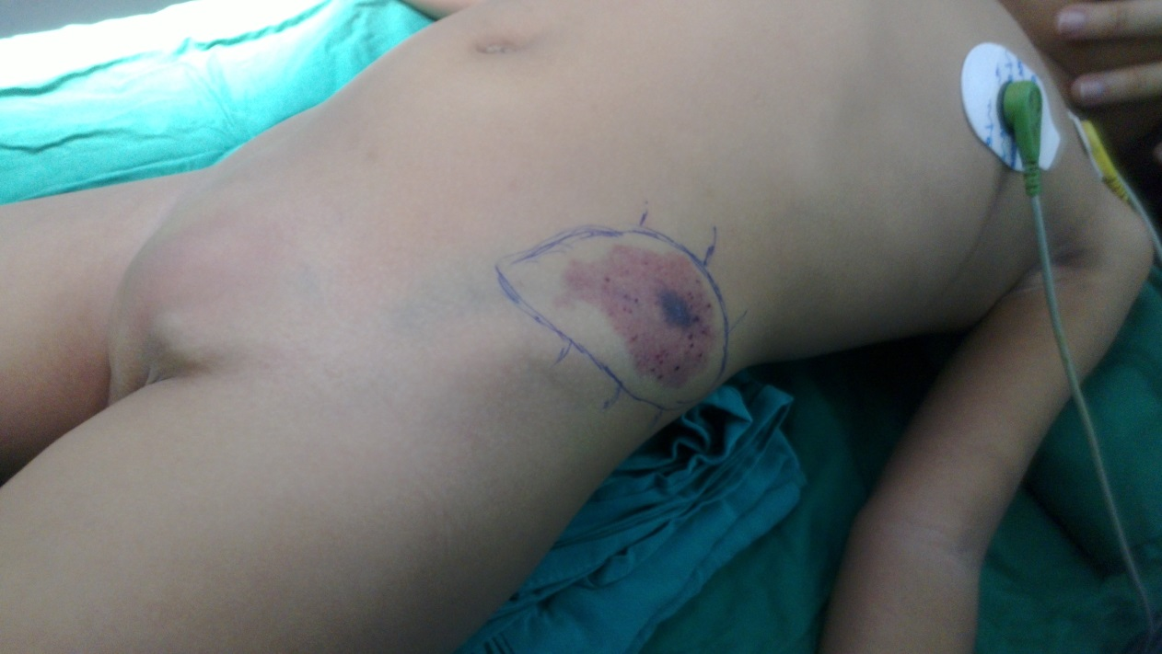

Slide 17
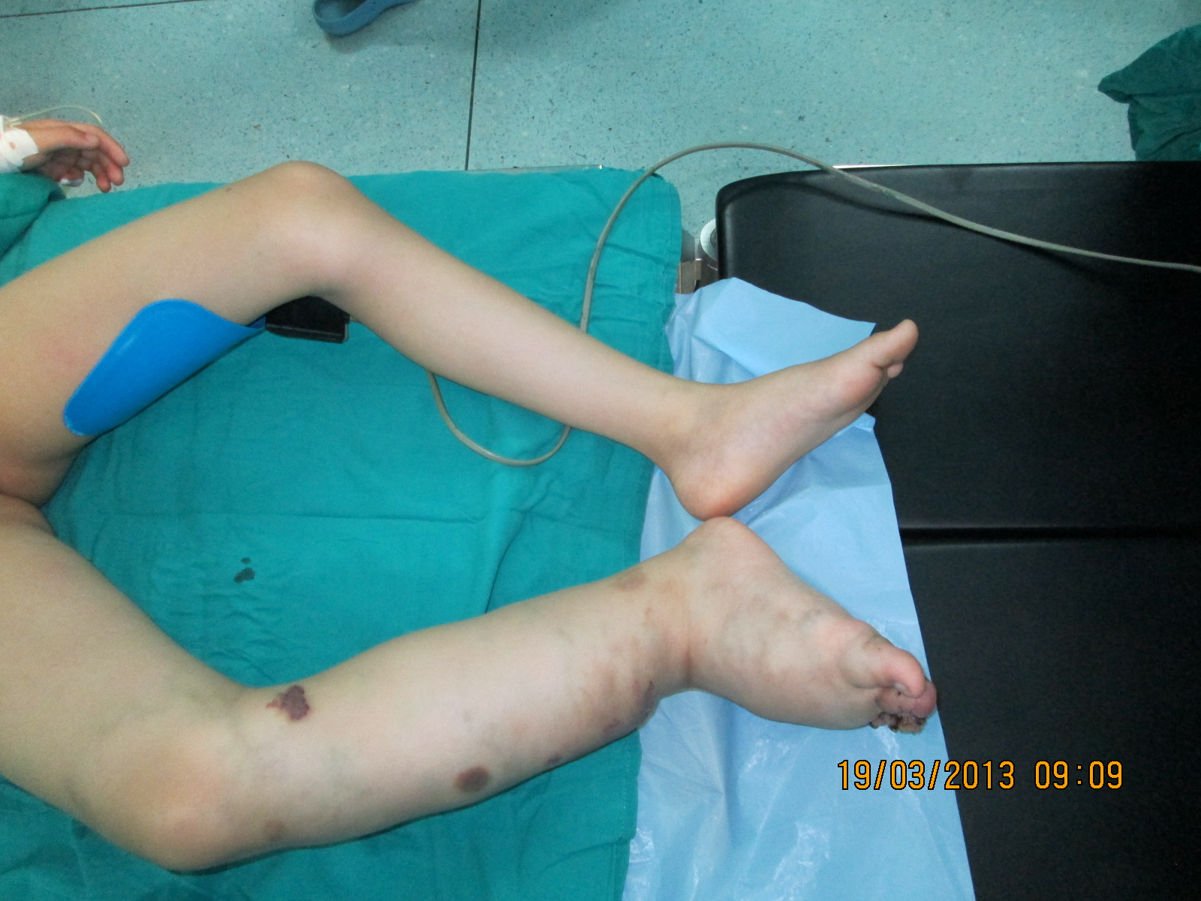

Slide 18


Slide 19
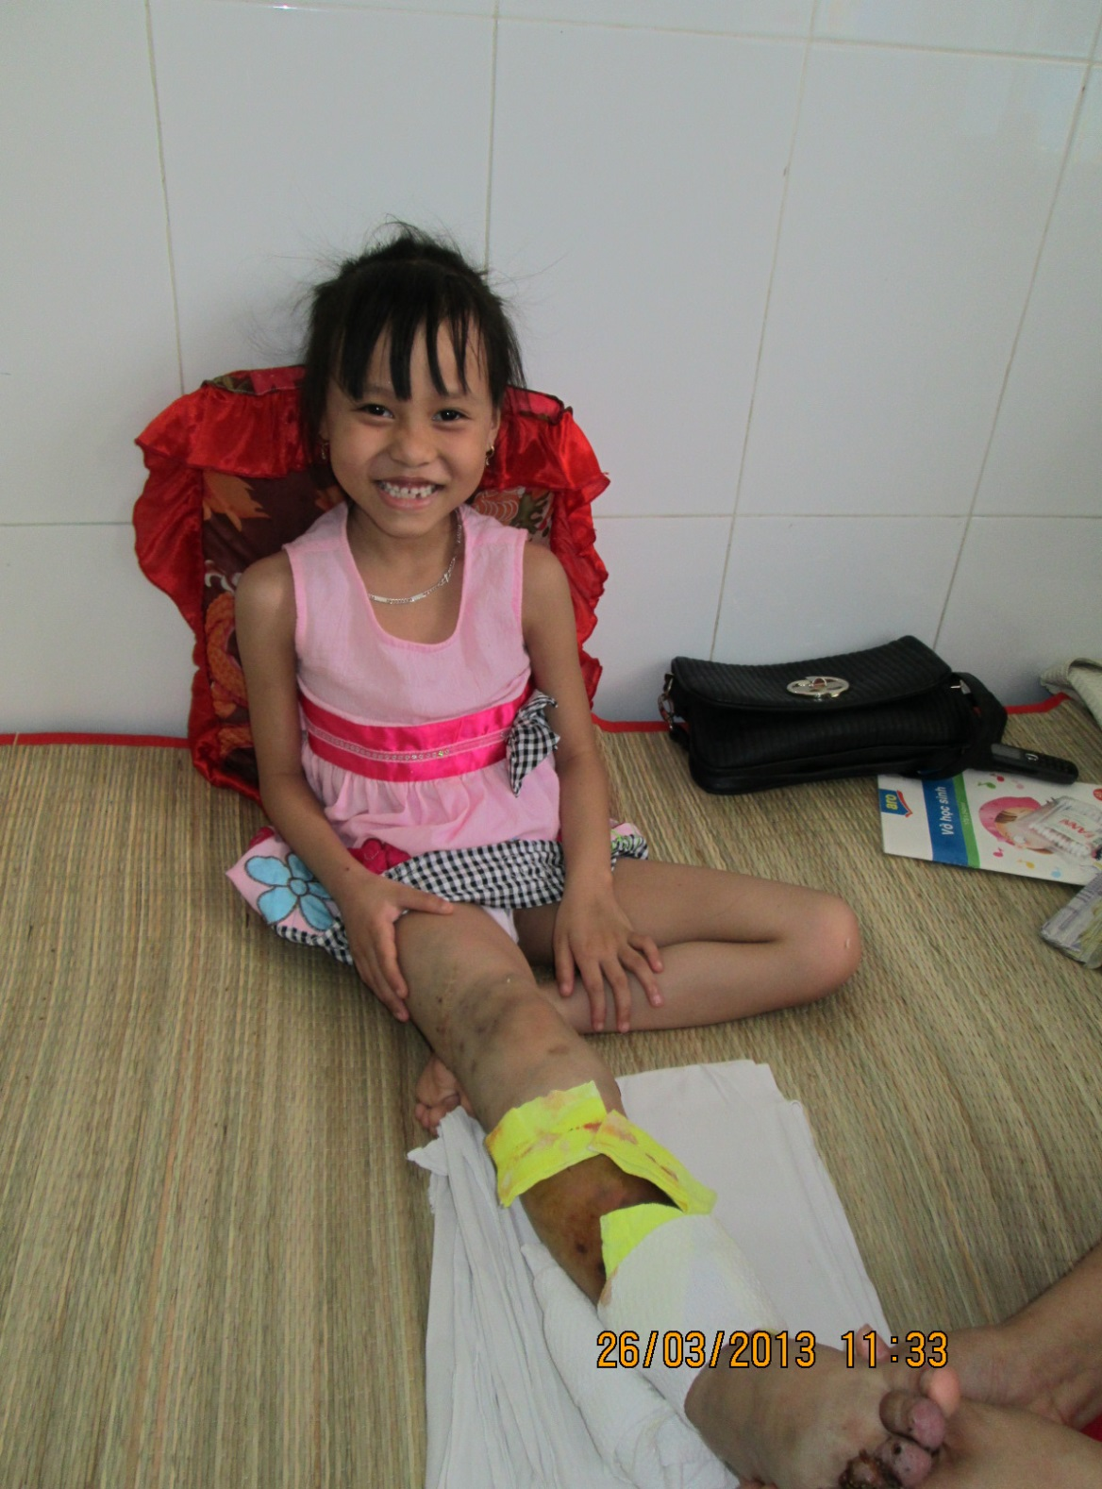

Slide 20
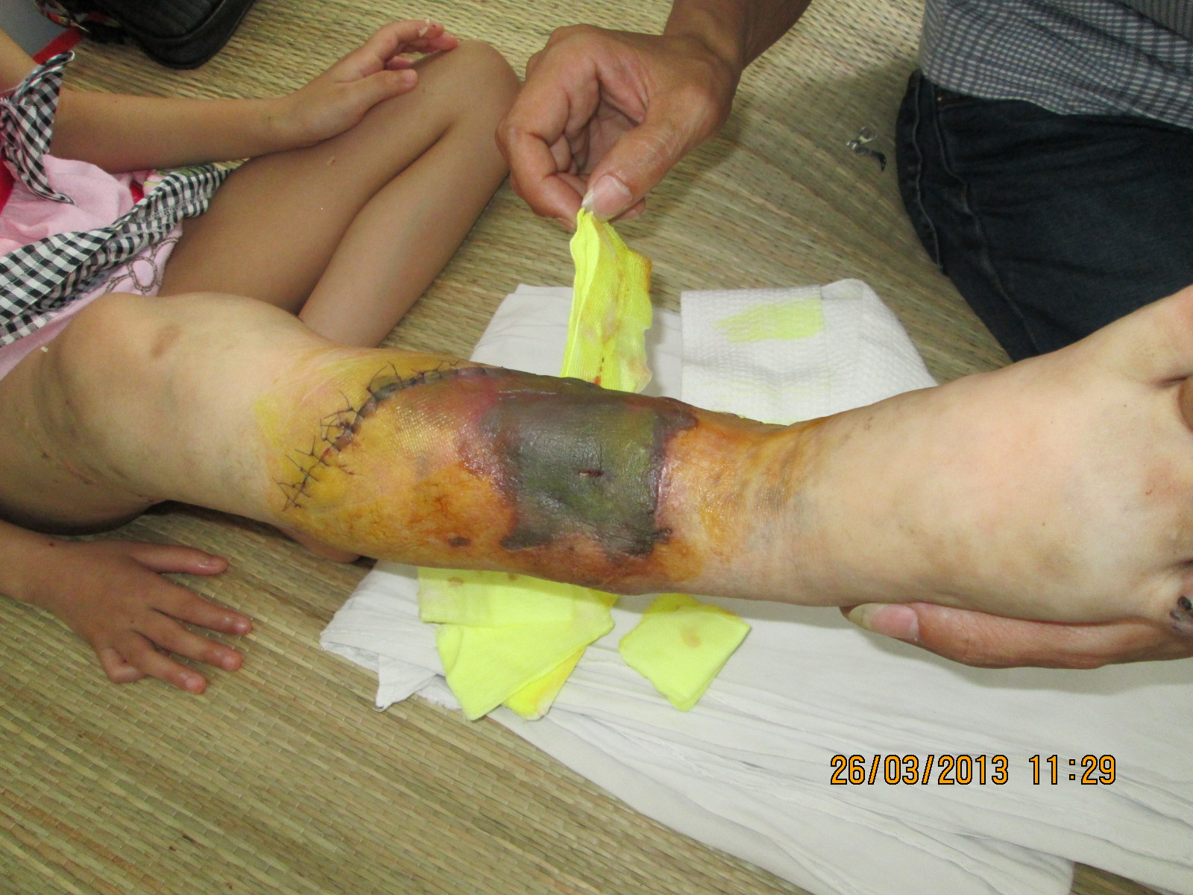

Slide 21
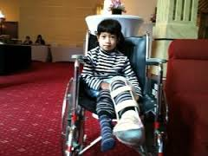

Slide 22
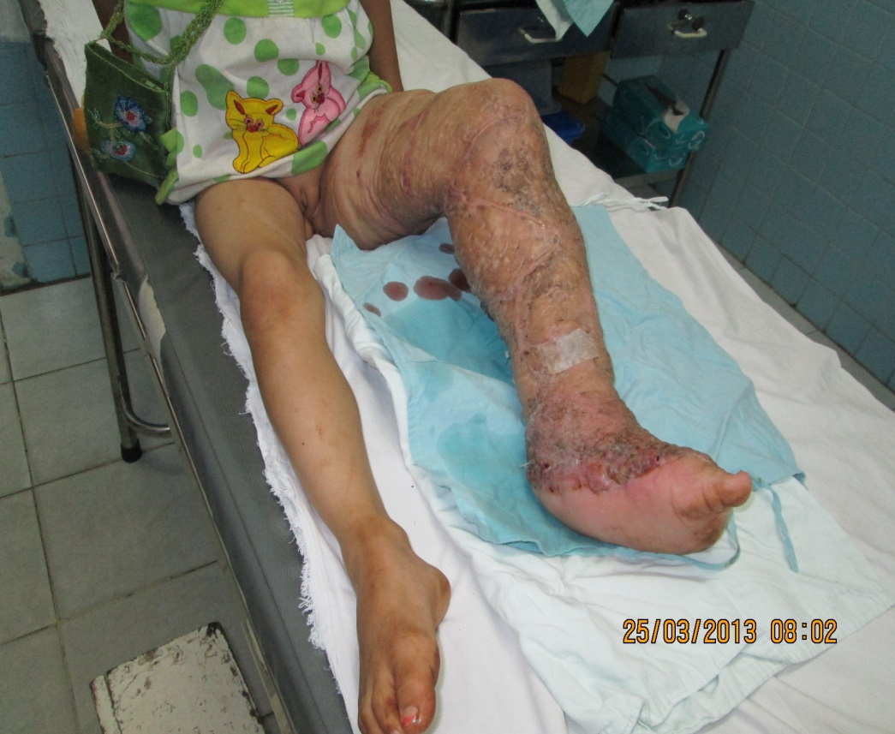
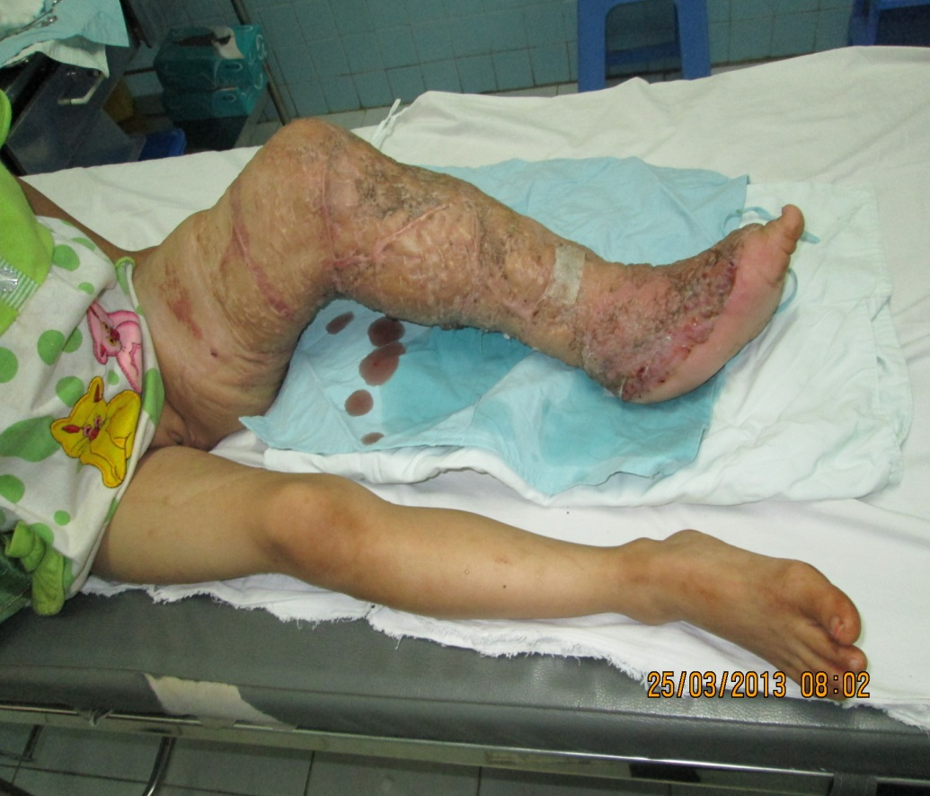

Slide 23
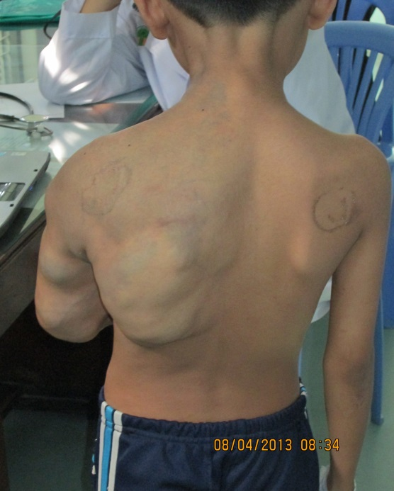
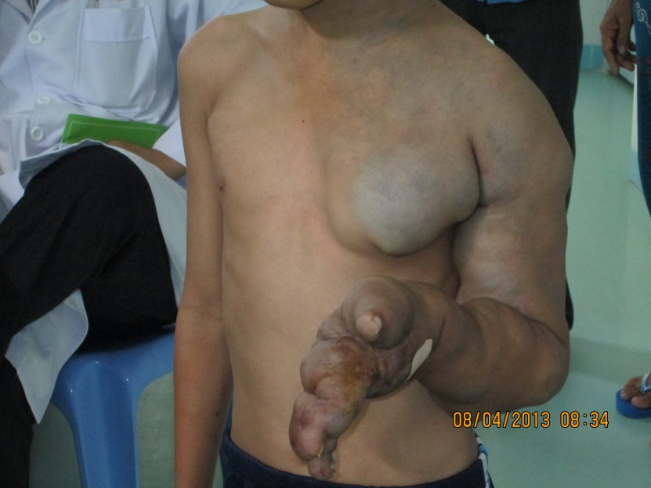
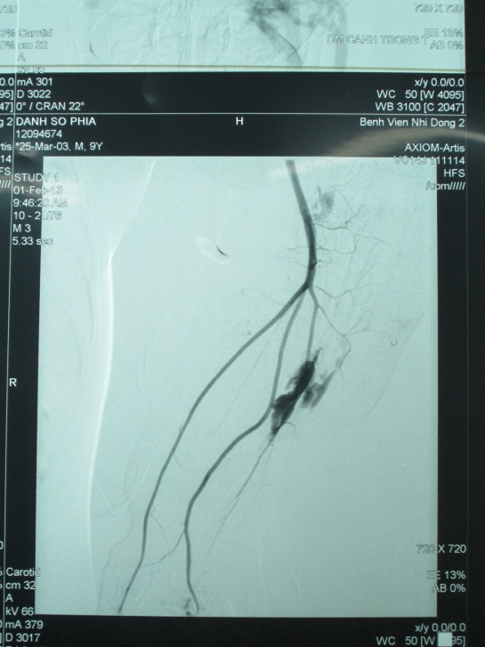
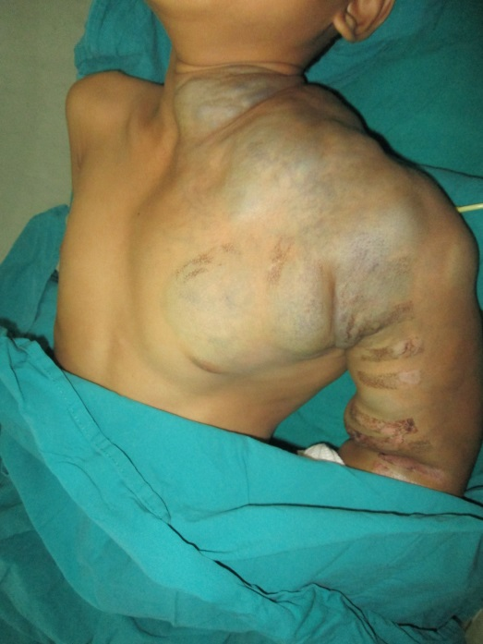
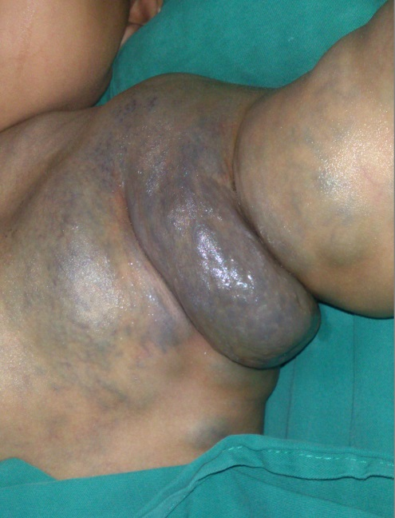

Slide 24
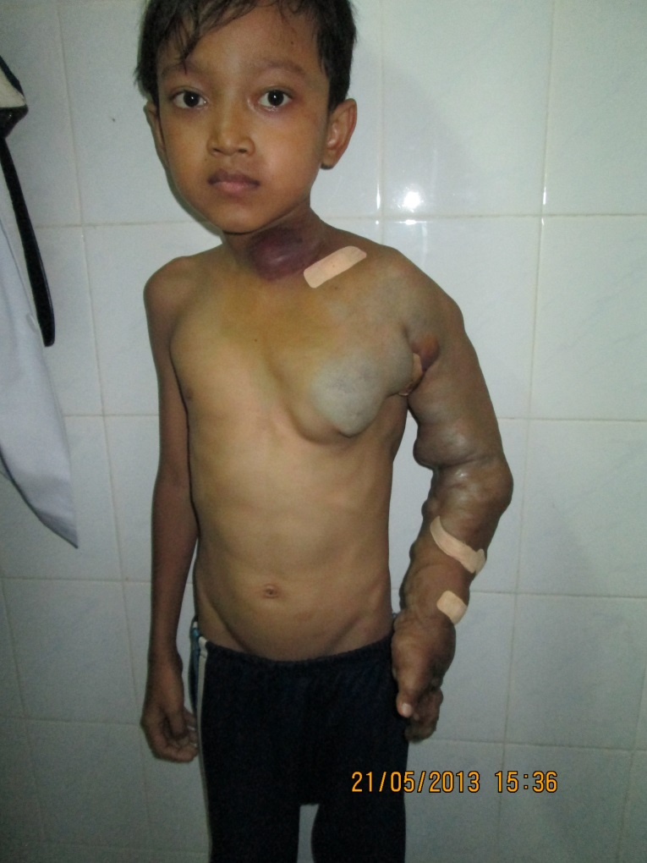
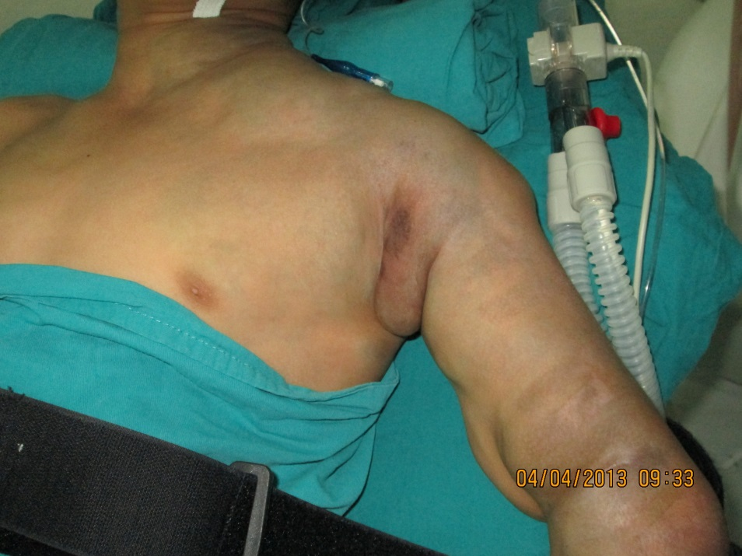

Slide 25
THANK YOU FOR YOUR ATTENTION

